Slide 1

Module Seven: Digital Citizenship in the Information Age
CYB 303 – Prof. C. R. Johnson

Slide 2
Elements of Digital Citizenship
Digital citizenship is the continuously developing norms of appropriate, responsible, and empowered technology use.
All people that engage in technology use, to any level, contribute in some way to those norms, just as everyone contributes to culture and social norms.

Slide 3
What “Good” citizens do
-To lead and assist others in building positive digital experiences -To recognize that our actions have consequences to others -To participate in a manner for the common good

Slide 4
9 Elements of Citizenship
1. Digital Access is about the equitable distribution of technology and online resources. Citizens need to be aware of their community and who may or may not have access, not only in school but at home as well. 2. Digital Commerce is the electronic buying and selling of goods and focuses on the tools and safeguards in place to assist those buying, selling, banking, or using money in any way in the digital space. 3. Digital Communication and Collaboration is the electronic exchange of information. All users need to define how they will share their thoughts so that others understand the message. For younger people struggling to understand their place in the world, technology can help them find their own voices and express themselves.

Slide 5
9 Elements of Citizenship
4. Digital Etiquette refers to electronic standards of conduct or procedures and has to do with the process of thinking about others when using digital devices. 5. Digital Fluency is the process of understanding technology and its use. The better educated or “digitally fluent,” people are, the more likely they are to make good decisions online, like supporting others instead of making negative comments. Digital literacy includes the discussion of media literacy and the ability to discern good information from poor, such as “fake news” from real news. 6. Digital Health and Welfare refers to the physical and psychological well-being in a digital world. Technology provides many opportunities and enjoyment but knowing how to segment use with the needs of ourselves and others is key to a healthy, balanced life.

Slide 6
9 Elements of Citizenship
7. Digital Law refers to the electronic responsibility for actions and deeds and has to do with the creation of rules and policy that address issues related to the online world. Just as in the real world, the online world has had to create structure to protect those using these digital devices from harm. 8. Digital Rights and Responsibility are those requirements and freedoms extended to everyone in a digital world. This area of Digital Citizenship is about understanding when they are provided opportunities, such as the access to the Internet and use of online products. 9. Digital Security and Privacy is the electronic precautions to guarantee safety. Viruses, worms and other bots can be passed along from one system to another just like an illness. Understanding and being aware of attacks and how to prevent them are important skills for today and into the future.

Slide 7
S3 – Safe, Savvy, Social
Safety - Protecting yourself and others
Savvy - Educating yourself and others
Social - Respecting yourself and others

Slide 8
Things we usually lack
Relationships and Communication
I can identify safe and unsafe ways to communicate with others online
I can take steps to keep myself safe when communicating
I can identify healthy and unhealthy online relationships
Cyberbullying, Digital Drama, and Hate Speech
I can take steps to avoid drama online
I can identify potentially dangerous situations
I can identify steps to help others who are in dangerous situations
News and Media Literacy
I can identify credible news/media sources
I can properly cite information to give credit to the author

Slide 9
Facebook is a Seedy Dive Bar
Facebook is the preferred global platform used to self-manage the delinquent public images and reputations of at risk youth, gang members, and known offenders—even while incarcerated.
Given its obvious appeal to overtly anti-social groups and individuals, one can theorize Facebook is an inherently risk-prone and criminogenic environment to navigate.

Slide 10
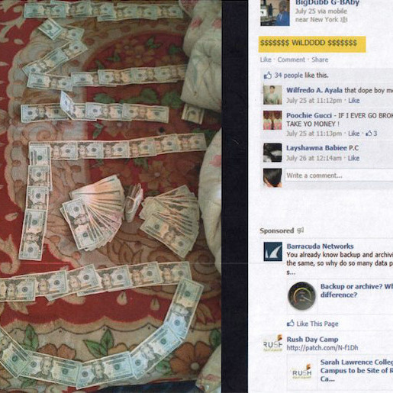
Facebook is a Seedy Dive Bar
While attendance in analogous offline environments would normally be dismissed by many as an unreasonable risk given similar identified hazards, indicators of collective delinquency, and proneness to victimization—biker bars, raves, violent demonstrations or other unruly assemblies, et cetera—Facebook’s perceived redeeming qualities apparently make it an acceptable risk.

Slide 11
YouTube Goes “Kid Safe”
We’re still settling on how to reconcile that, and as has always been the case, it begins with children. Google recently made an effort to segregate (not censor) YouTube content for children.
But it turns out that mandating proper classification is no good, and automatically determining content is a problem as well.
In fact, you might recall the effort led to a flood of vitriol from content creators who lost add revenue due to “the algorithm.” Which even led to direct violence on the YouTube corporate offices. Here is Nasim the night before the shooting.

Slide 12
Math Rules All
The question becomes not whether some platforms have greater rights to speech than others – clearly the answer is yes. More troubling is the control over speech.
The banality of evil? It’s not personal – it’s just business. If you control the news you control what people think.
Search and social media algorithms determine what you see.

Slide 13
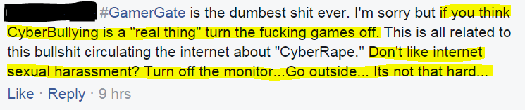
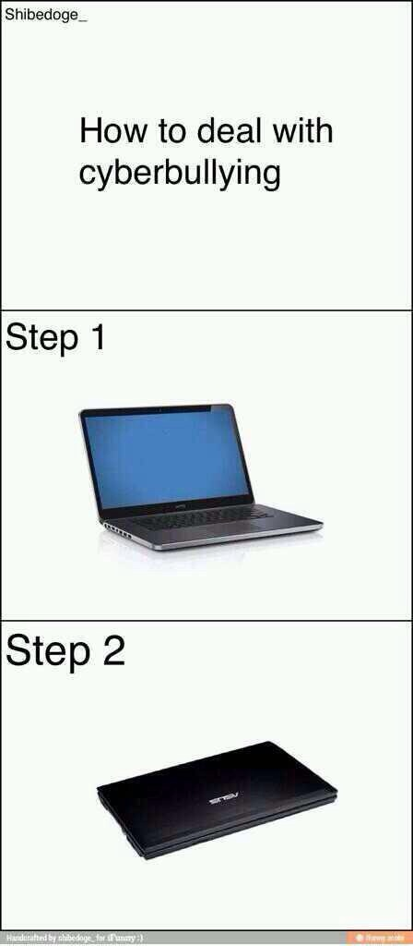
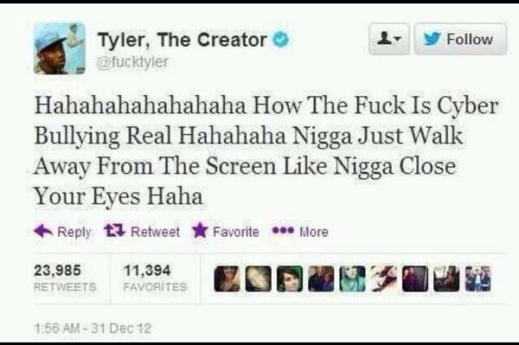

Slide 14
Cyberbullying Victimology
Incidents of humiliation and torment are not a matter of theory—they expose the harsh realities of cyberbullying as perhaps the least understood area of victimization in the digital age, and one of the most socially topical and divisive issues of our time.

Slide 15
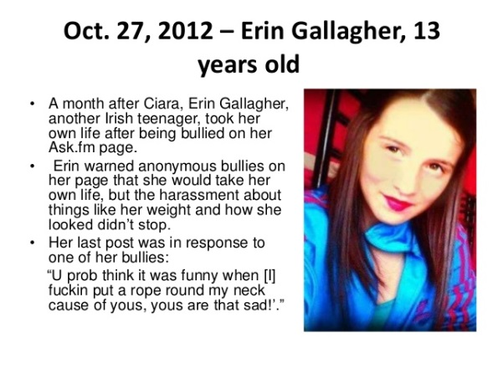
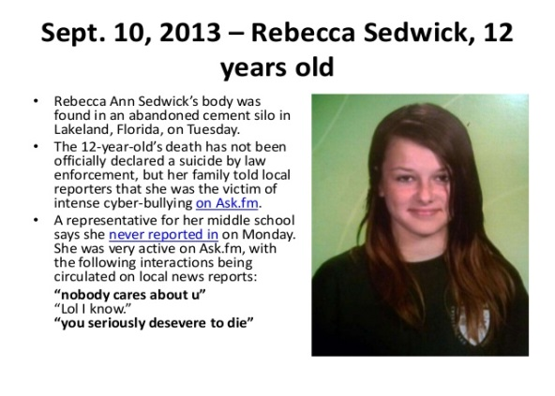
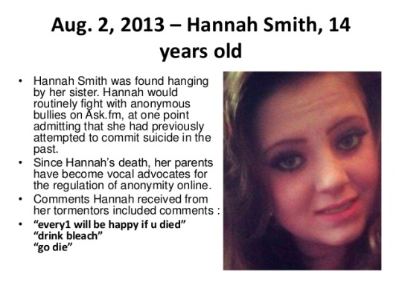
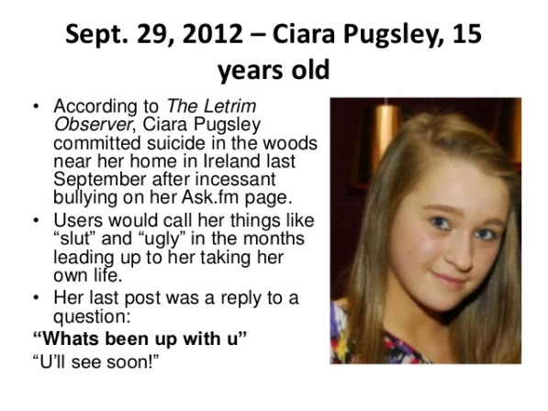
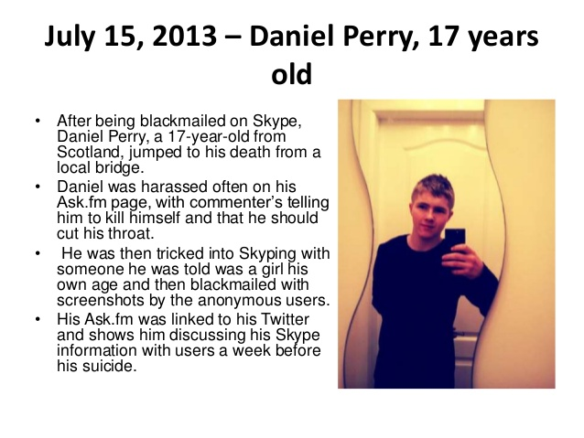
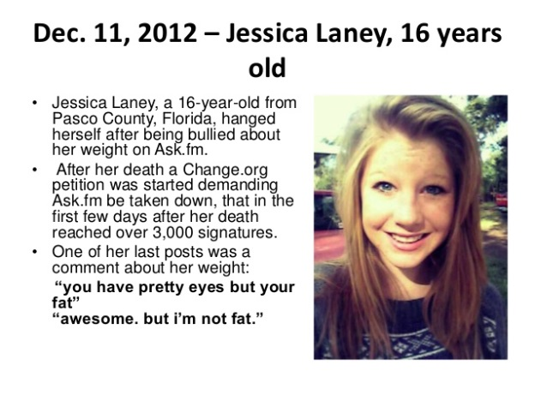
“[…] Sadism leads to trolling because those behaviors are pleasurable.”
- E.E. Buckels et al.
Personality and Individual Differences

Slide 16
The National Violent Death Reporting System (NVDRS)
Number of suicides by age group and sex: USA, 2016.
Age (years) | 10 – 14 | 15 – 24 | 25 – 34 | 35 – 44 | 45 – 54 | 55 – 64 | 65 – 74 | 75+ | Unknown | All
Males | 265 | 4575 | 5887 | 5294 | 6198 | 5745 | 3463 | 3291 | 2 | 34727
Females | 171 | 1148 | 1479 | 1736 | 2239 | 2014 | 940 | 510 | 1 | 10238
Male/Female Ratio | 1.5 | 4.0 | 4.0 | 3.0 | 2.8 | 2.9 | 3.7 | 6.5 | 1.0 | 3.4
Total | 436 | 5723 | 7366 | 7030 | 8437 | 7759 | 4403 | 3801 | 3 | 44965

Slide 17
But who is cyber-bullied?
Persons with a disability, be it developmental (75%), physical (70%), or learning (52%)
Meanwhile, offenders are more likely female (63%) if under 16 but shifts to overwhelmingly male buy age 23.
Tend toward dark tetrad traits of sadism and psychopathy. The gender swap is generally consistent with the presentation and suppression of these traits in socialization.

Slide 18
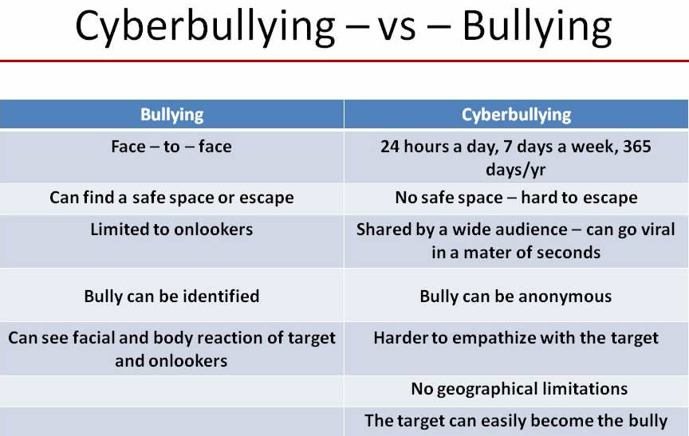

Slide 19
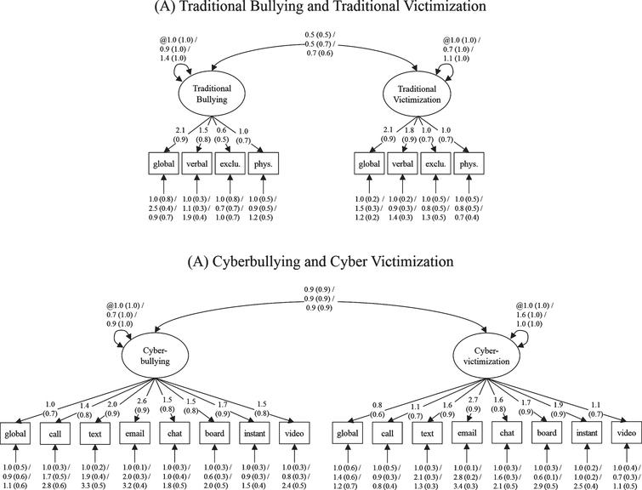

Slide 21
Cyber-bullying to cyber-harassment
There’s no real hard line between what is considered cyber-bullying and cyber-harassment because the distinction is not really a legal one. Both fall under WIS 947.0125 “Unlawful use of a computerized communication system”

Slide 22
WIS 947.0125
Class B misdemeanor:
Send message will intend to frighten, intimidate, threaten, abuse, or harass.
Doxing with same intent.
Responding to threats with threats.
Class B forfeiture:
Send obscene or profane messages with intent to harass, annoy, or offend.
Convince someone else to do it for you.

Slide 23
Cyber harassment to cyber-stalking
There is a clear legal definition for cyber-stalking, which in Wisconsin 940.32 means the harassment constitutes a “course of conduct”
CoC is 2 or more acts “carried out over time” of unwanted contact.

Slide 24
Wire Fraud
The elderly are primary victims, and most likely to be significantly impacted by it.
Followed by those of the functionally illiterate and casual user varieties.
What we’re talking about here are confidence scams, mostly.
Online Shipping / Auction Scams (F 30-49)
Computer Software Fraud (M 60-79, F 40-59)
Malware/Spyware (M 60-79, F 40-59)
Hacking/Social Media (F/M 30-49)

Slide 25
Wire Fraud
A victimology report by the City of London is a pretty clear picture of cyber-fraud victims in general: https://www.cityoflondon.police.uk/news-and-appeals/Documents/Victimology%20Analysis-latest.pdf

Slide 26
Business as a Victim
Business victims tend to be… (2005)
Telecommunications, Manufacturing, or Health Care…
Either very large with over 1000 employees, or relatively large with 100-999… Most attack vectors are companies of 50 or fewer employees.
Who was targeted for trade secrets or PII…
With malware... By…
If the intent is theft, an Insider. If the intent is to attack, an Outsider…
And they probably never reported it to the authorities.

Slide 27
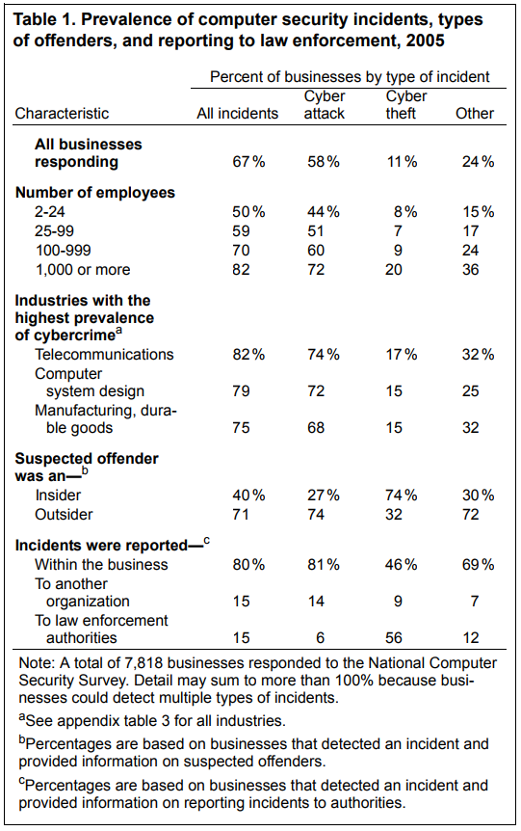
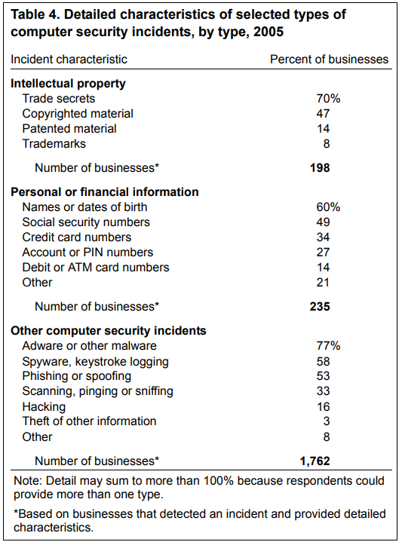

Slide 28
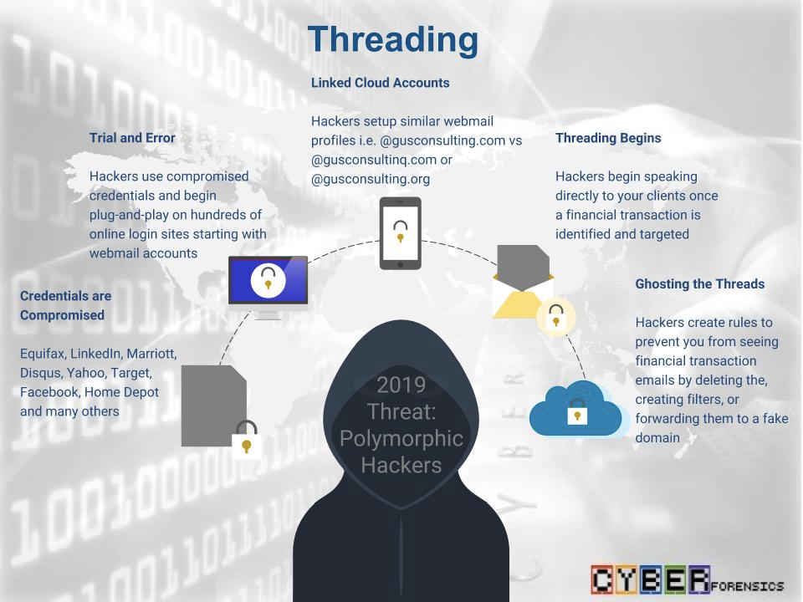

Slide 29
Computer Crime Laws
The technological explosion of the last three decades caught the world off guard.
The legal system especially was not prepared for the Internet.
The Internet has been a source of legal concern from the very beginning. In the early days there was absolutely no law enforcement presence on the Internet.
Even when business first got involved in the mid 90s, it took years for law enforcement to catch up.
Think of it like Manifest Destiny – rapid expansion of territory with little to no government presence – the Old Internet was the Wild West.

Slide 30
Business Brings Laws
The commercialization of the Internet is what finally brought attention over lawmakers and law enforcers. Suddenly money was at stake, and the free market dictates that it be made less free.
Domain name disputes. (Panavision v. Toeppen)
Trademarks
Enforceability of online contracts
Copyright issues

Slide 31
What’s Old is New
Horse Laws – Before the automobile, our primary means of conveyance aside from walking was horses. When automobiles came around, the law found new legal questions to answer, and stretched horse laws (ancient in some cases) to automobiles.
The same is true for modern technologies (like stretching the tort of trespass to chattels to address spam.)

Slide 32
State Internet Laws
WIS 134.98 – Data Breach Notification
Requirement to notify within 45 days if personal information is leaked.
WIS § 947.0125 Unlawful use of computerized communications
Involves annoying or threatening communications via a computer.
WIS 943.70 Computer Crimes

Slide 33
The CFAA
As computer crimes continued to grow in sophistication and as prosecutors gained experience with the CFAA, the CFAA required further amending, which Congress did in 1988, 1989, 1990, 1994, 1996, 2001, 2002, and 2008.
By this time, the definition of coverage of the CFAA is essentially the fullest extent of Congress’ commerce powers.

Slide 34
the CFAA
Section 1030(e)(2) defines protected computer as a computer—
(A) exclusively for the use of a financial institution or the United States Government, or, in the case of a computer not exclusively for such use, used by or for a financial institution or the United States Government and the conduct constituting the offense affects that use by or for the financial institution or the Government; or
(B) which is used in or affecting interstate or foreign commerce or communication . . . .
Note that the computer must be “used in or affecting” not “used by the defendant in”—that is, it is enough that the computer is connected to the Internet; the statute does not require proof that the defendant also used the Internet to access the computer or used the computer to access the Internet.

Slide 35
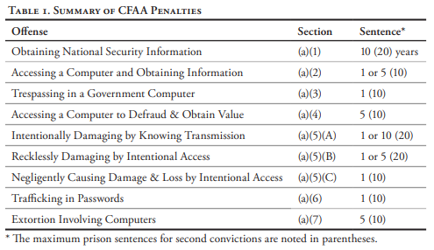
CFAA Offenses & Penalties

Slide 36
Lessig’s Framework
Restraints on behavior on the Internet:
Law
Norms
Market
Architecture
Some a greater motivator than others, but all limit behavior.

Slide 37
Dirty Rhetorical tricks – Rational Persuasion
Gish Gallop – Inundating the influenced with so much information at once that it’s impossible for the influencer to parse and process all of it.
Bullshit § Bullshit – Using language that intentional obfuscates the logic of an argument, as in nonsense jargon, slang, or archaic words. “I must have your password because the visual SMS HDD went belly up and the whole Unicode processor bandwidth can no longer find your account in the memory stack.”
Bullshit Asymmetry Principle – The amount of energy required to refute bullshit is an order of magnitude greater than the energy required to produce it.
1995 – Hackers

Slide 38
Dirty Rhetorical tricks – Rational Persuasion
Chewbacca Defense – Presenting a distracting argument that is facile and specious by presenting the correlation of non-sequiturs.
Filibustering – Completely controlling or dominating a conversation without giving the other party an opportunity to provide input. Particularly effective on observers, less so on the other party.
Nail in the coffin – Getting in the last word tricks observers into tending to find that person correct in an argument. Doesn’t even need to make sense – just sound like it does.

Slide 39
Dirty Rhetorical tricks – Rational Persuasion
Proof by Intimidation - Known in maths… Hand-waiving arguments as obvious or expecting presented arguments merely be accepted with analysis. “Obviously…”
Ad Hominem – Attacking, threatening, or belittling the arguer instead of the argument.
Smoke and Mirrors – Distracting or misdirecting from an argument by presenting an unrelated issue.
No True Scotsman – Intentionally excluding counterexamples.
Cherry-Picking – Intentionally including select examples.

Slide 40
Dirty Rhetorical Tricks - Trolling
Sealioning - The troll feigns ignorance and politeness, so that if the target is provoked into making an angry response, the troll can then act as the aggrieved party. Also – incessant, bad-faith invitation to engage in debate.”
Gaslighting – Denying or altering facts to make the target’s argument seem nonsensical, illogical, or insane.
Virtue Trolling – When a troll takes the position that they are correct, regardless of what it is, because it is virtuous and therefore any other position is unvirtuous.

Slide 41
Dirty Rhetorical Tricks - Trolling
Concern Trolling – Detracting or disruption dialogue under the guise of concern.
Iconoclast / Sophists – A troll with the mission of educating the masses who will link to sources to support their position, but the links are intellectually dishonest. Their arguments are facile and specious.

Slide 42
Hacking Humans
The Dark Arts of Social Engineering
1:48, 10:22, 14:41, 28:32
Real Future: Daring Hackers to Hack You

Slide 43
The pen is mightier than the sword
If your opponent is of choleric temper, try to irritate him. If he is arrogant try to encourage his egotism. If the enemy troops are well prepared after reorganization, try to wear them down. If they are united, try to sow dissension among them.
One need not destroy one's enemy. One need only destroy his willingness to engage.
The Art of War
There are but two powers in the world, the sword and the mind. In the long run the sword is always beaten by the mind.
Napoleon Bonaparte
One cannot wage war under present conditions without the support of public opinion, which is tremendously molded by the press and other forms of propaganda.
General Douglas MacArthur

Slide 44
The pen is mightier than the sword
They were using my books as the basis for a destructive campaign against the Jews of Germany. This shocked me, but I knew any human activity can be used for social purposes or misused for antisocial ones.
Edward Bernays
“professional poisoners of the public mind, exploiters of foolishness, fanaticism, and self-interest.”
Supreme Court Justice Felix Frankfurter

Slide 45
Cognitive Hacking
Communication is systems within systems.
Systems can be corrupted.
Information is power.
Electioneering, politicking
We even do a lot of the work ourselves
Echo chambers
Tribalism

Slide 46
Zeitgeist manipulation
Explicit or incidental manipulation of communication and information seeking systems with the intent to or resulting in the manipulation of:
Public opinion
Civil unity
Political activism (subterfuge)
Corporate or political adversaries
Public perception or belief.

Slide 47
Free Will
Social media uses algorithms that can be manipulated. As parts of our communication and information seeking systems, this means it is quite simple to:
Poison the well
Data seeding
Werther Effect
Internet bots such as social bots, votebots and clickbots – image manipulation – sloganeering

Slide 48
The Secret sauce
Ads with storylines are very effective
Informative demonstrations boost ad performance
Simple outperforms complicated
Slice-of-life and transactional or promotional ads can both work
Humor is effective at driving recall, brand favorability and likeability, but not all types of humor are equal
Character interaction matters a lot
Notes:
The team, along with its market-research shop Added Value, painstakingly code commercials for such things as the type of humor. And they found, according to Mr. Pharo, that ads featuring humor deemed clever, sarcastic or snarky tend to outperform ads with silly humor (though Mr. Samuel noted that ads with darkly sarcastic humor tend to underperform).

Slide 49
VAD MOdel
Valence is the positivity or negativity of an emotion. Happiness has a positive valence; fear has a negative valence.
Arousal ranges from excitement to relaxation. Anger is a high-arousal emotion; sadness is low-arousal.
Dominance ranges from submission to feeling in control. Fear is low-dominance; an emotion a person has more choice over, such as admiration, is high-dominance.

Slide 50
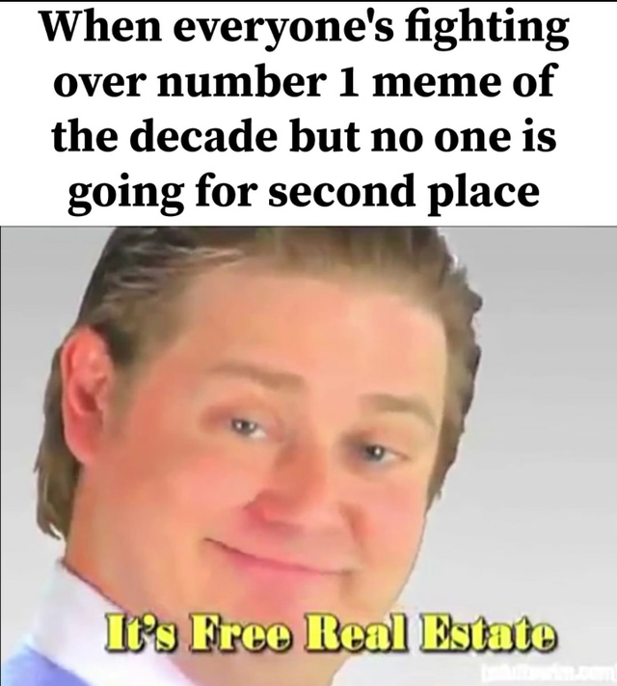
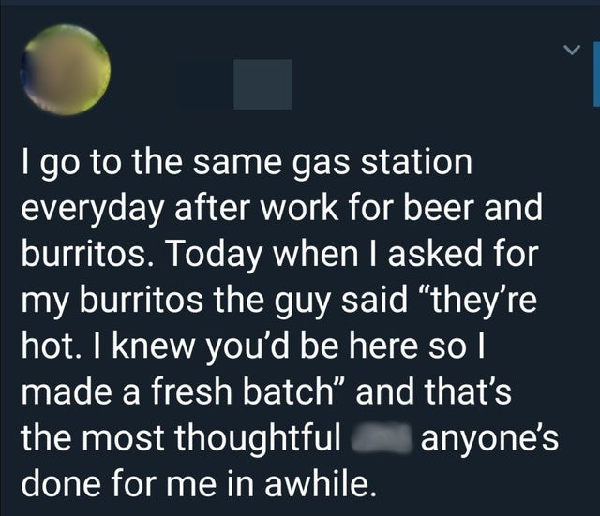
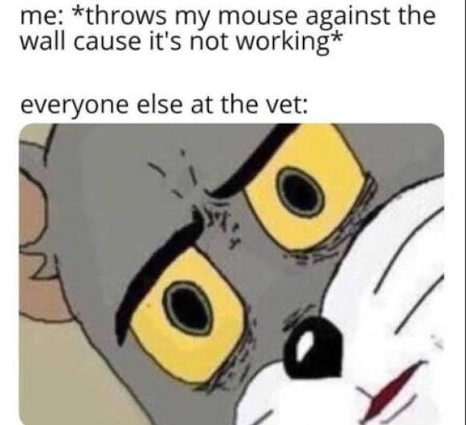
Imagine four balls at the edge of a cliff… memes work the same way
Amusing and surprising
Wholesome
Dark humor

Slide 51
Planting the seed
High-arousal emotion virality:
 | High Arousal | Low Arousal
Positive | Awe (Wonder) Excitement Amusement | Contentment Calm
Negative | Anger Anxiety Disgust | Sadness Pity
Notes:
Content that evokes high-arousal emotions (e.g. awe, anger or anxiety) is more viral.

Slide 52
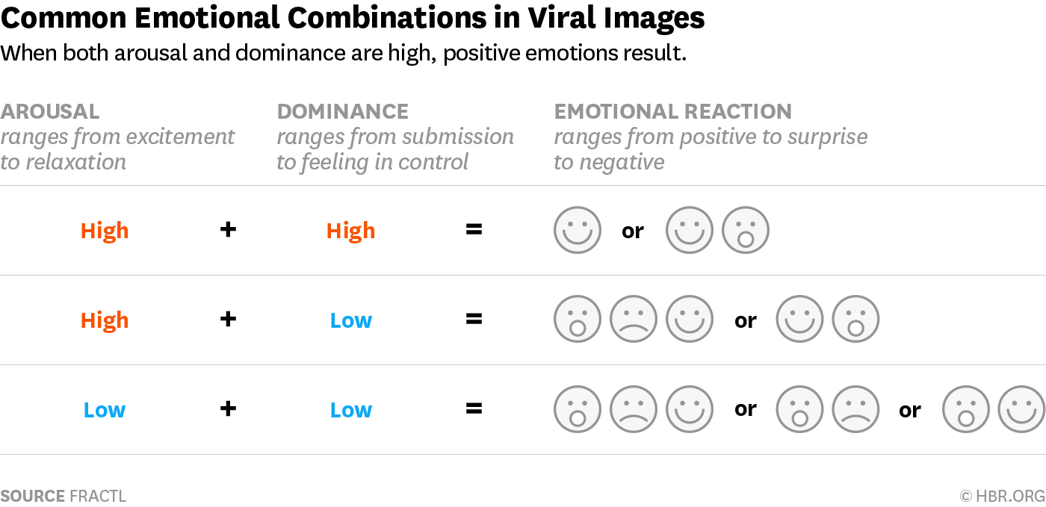
Notes:
Some theorize that a person's tendency to share certain content, and thus virilize it, may be rooted in self-preservation instrincts. Sharing positive content makes the sharer look positive, even if they didn’t create it.

Slide 53
Planting the seed
Simplicity over complexity: Providing and perpetuating simple explanations for complex circumstances
Low-information rationality
Peer-influence: Prior collective ratings of an web content influences ones own perception of it. Bandwagoning / snowball voting.
Filter bubbles: Echo chambers and filter bubbles might be created by Website administrators or moderators locking out people with altering viewpoints or by establishing certain rules or by the typical member viewpoints of online sub/communities or Internet "tribes"
Notes:
In 2015 it was shown that the perceived beauty of a piece of artwork in an online context varies with external influence as confederate ratings were manipulated by opinion and credibility for participants of an experiment who were asked to evaluate a piece of artwork.[Furthermore, on Reddit, it has been found that content that initially gets a few down- or upvotes often continues going negative, or vice versa. This is referred to as "bandwagon/snowball voting" by reddit users and administrators.
[citation needed] Specific points, views, issues and people's apparent prevalence can be amplified,[14] stimulated or simulated. (See also:)

Slide 54
Planting the seed
Confirmation bias & manipulated prevalence: Fake news does not need to be read but has an effect in quantity and emotional effect by its headlines and sound bites alone.
Mere-exposure effect: A psychological phenomenon by which people tend to develop a preference for things merely because they are familiar with them
Information timeliness and uncorrectability: Clarifications, conspiracy busting and fake news exposure often come late when the damage is already done and/or do not reach the bulk of the audience of the associated misinformation
Notes:
In 2015 it was shown that the perceived beauty of a piece of artwork in an online context varies with external influence as confederate ratings were manipulated by opinion and credibility for participants of an experiment who were asked to evaluate a piece of artwork. Furthermore, on Reddit, it has been found that content that initially gets a few down- or upvotes often continues going negative, or vice versa. This is referred to as "bandwagon/snowball voting" by reddit users and administrators. Specific points, views, issues and people's apparent prevalence can be amplified,] stimulated or simulated. (See also:)

Slide 55
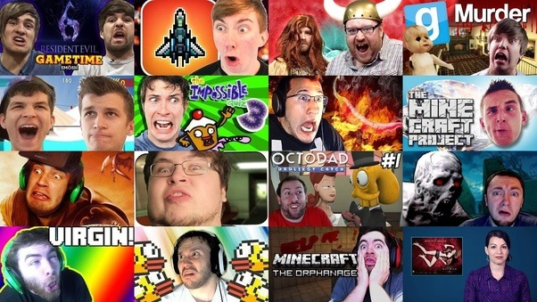

Slide 56
You are who we are together
Psychological targeting: Social media activities and other data can be used to analyze the personality of people and predict their behaviour and preferences
Matz, et al. (Dr. Michal Kosinski) 2017
Kotikalapudi, et al. 2012

Slide 57
Big Five
To understand any of the research on behavioral correlates you need to understand what the Big Five personality traits are, because so much of the research relies on measuring different factors along those lines.
Extroversion (sometimes called Surgency). The broad dimension of Extroversion encompasses such more specific traits as talkative, energetic, and assertive.
Agreeableness. Includes traits like sympathetic, kind, and affectionate.
Conscientiousness. Includes traits like organized, thorough, and planful.
Neuroticism (sometimes reversed and called Emotional Stability). Includes traits like tense, moody, and anxious.
Openness to Experience (sometimes called Intellect or Intellect/Imagination). Includes traits like having wide interests and being imaginative and insightful.

Slide 58
Big Five & Dark Tetrad
Keep in mind that the Big Five are separate from the Dark Tetrad – it is entirely possible to have an agreeable sociopath, a neurotic narcissist, etc. But they do play off each other.
For example, a narcissist that is also extroverted or neurotic is much more likely to utilize social media in a destructive way, as studies show those with the Big Five traits of neuroticism and extraversion tend to gravitate toward social media usage, and the Dark Tetrad tells us they are likely a toxic personality.
Narcissists tend to engage in “attention-seeking behavior” online – extraverted might post tell self-centered stories, neurotics might post shocking stories

Slide 59
Self-Representation
The way a person presents themselves online can provide clues – Take the following profile pictures for example. They are both similar at first blush, but if you look you will notice differences – facial expression, lighting, color palate. Profile picture is a deliberate choice, which the person selects to represent them – it is how they want others to see them.
The results:

Slide 60
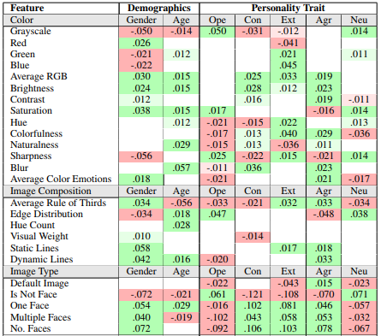
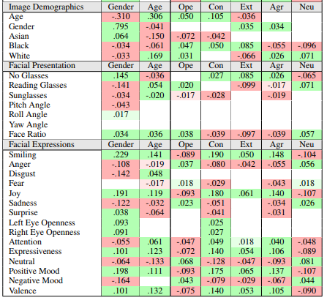
Self-Representation
The way a person presents themselves online can provide clues – Take the following profile pictures for example. They are both similar at first blush, but if you look you will notice differences – facial expression, lighting, color palate. Profile picture is a deliberate choice, which the person selects to represent them – it is how they want others to see them.
The results:

Slide 61
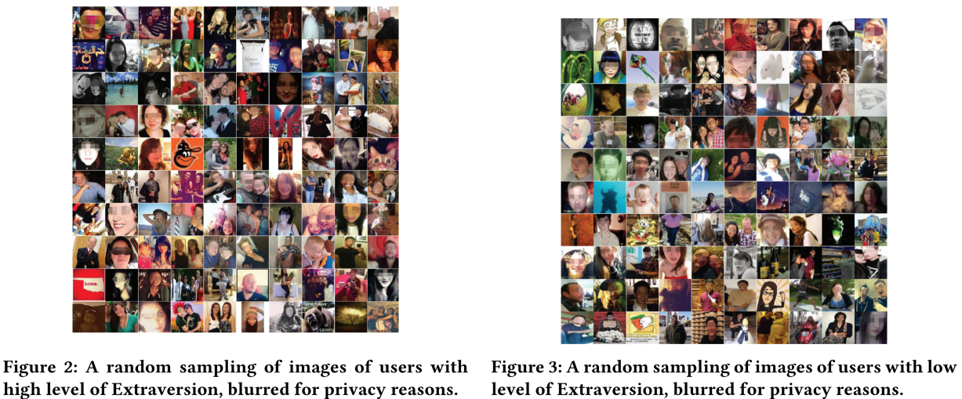

Slide 62

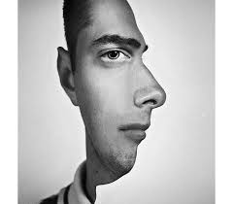
Big Five & Photos
Openness – Profile pics other than faces, revealing non-conformance to expectations. More likely greyscale.

Slide 63


Big Five & Photos
Conscientiousness – Profile pics will be joyful, single-subject, and likely color. Look for smiling faces that give the impression of disarming. If not, then a quick candid shot appropriate for their personality. The choice of photo will be deliberate, but utilitarian.

Slide 64
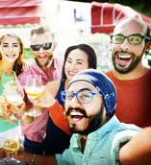
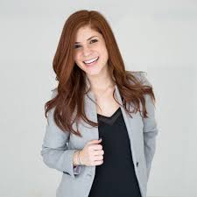
Big Five & Photos
Extroversion – Tends to have pictures with multiple faces in them. Probably very colorful. Tend to look very polished, putting the best foot forward and clearly mindful of how the picture reflects upon them.

Slide 65


Big Five & Photos
Agreeableness – Likely use color photos of themselves but tend to be less aesthetically pleasing or “staged” – blurry photos or clearly untouched photos are most likely.

Slide 66
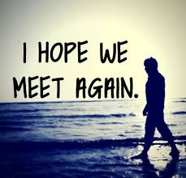
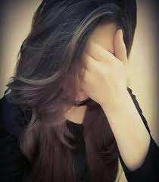
Big Five & Photos
Neuroticism – Simple, uncolorful pictures with muted color palates. Tend not to use faces, but when they do they usually wear glasses and the face takes up more of the space.

Slide 67
Profile Pics
Again, this can also be aggregated – those that keep “default” pictures tend to be perceived different as well, such as the following sentiment on Twitter egg avatars:
“Someone with an egg avatar is either too stupid to figure out how to change it, in which case block, or so new to Twitter that he or she is unfamiliar with the customs or niceties of interactions, in which case block.”
“A person with under 10 followers and an egg avatar is the absolute quickest to hop in your mentions on some bs,”
“Trying to engage ppl on twitter while u have an egg avatar is the same as attempting to have a conversation with no pants on.” @desusnice
“i always get SO THROWN when someone with an egg avatar says something normal and not hideous/racist” @abovoadmala

Slide 68
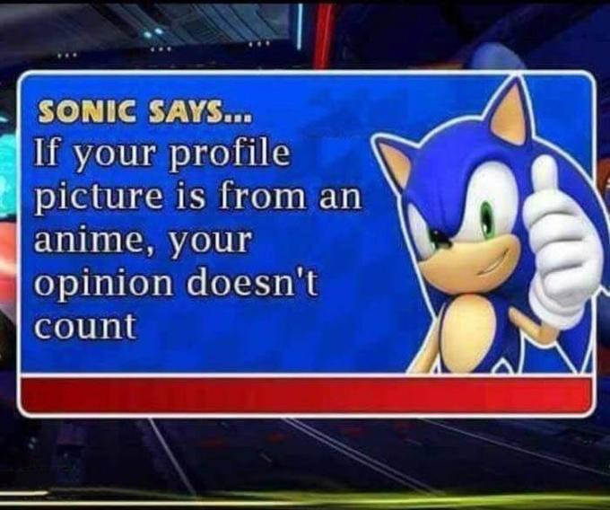
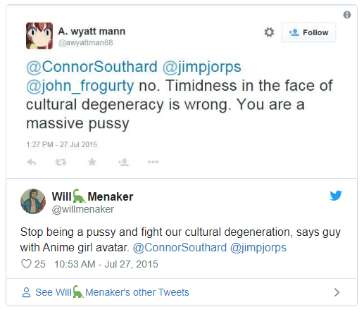
Profile Pics
And then there are those that self-select certain ubiquitous flavors of pic:
Anime avatar people tend to fall more into the “openness” aspect of the Big Five – especially leaning into the subversion of expectations aspect which, combined with narcissism or sadism traits become recalcitrance.
“Likelihood of sexism: Avatar is a dog: 40% Avatar is an anime character: 73% Avatar is a car: 100%” @Beschizza

Slide 69
More Than Mean
The phenomena of an individual behaving differently around friends than family is well-studied, but the interesting thing is how differently we behave when we
1) Can select how we present ourselves
2) Where we present ourselves
3) Have perceived anonymity
4) Can easily depersonalize others
Essentially, for many of us, when given the chance to be whatever we want, we chose the worst part of us. This is where everyday sadism comes in – sometimes we are not satisfied with who we have to be every day, so the frustration is released online.
It’s easy to see how inappropriate this behavior is when you take away the anonymity and depersonalization.

Slide 70
